Slide 1
Prototyping Model
Software Development Lifecycle

Slide 2
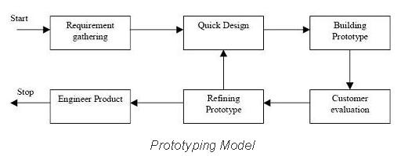
Application of the model
The Prototyping model is similar to the Spiral model in that it has a core loop that only stops once the client is satisfied with the result. It differs from the Waterfall model as it is cyclical and iterative in nature.
The method itself involves gathering user stories and requirements, then production of a series of prototypes that are evaluated by the client. Refinements are then added and a new prototype is built, and the loop continues.
Once the client is satisfied with the state of the prototype and the final refinements are added, the software developers produce a final version of the software ready to be deployed.

Slide 3
Advantages and Disadvantages
The positive things about using this model include how the client is a core part of the main cycle, constantly being involved and witnessing how each prototype builds and functions. The usability and function of the software is also represented as the prototype can feature realistic code and UX features.
The issues with this method are that it’s difficult to scale up to larger projects, instead being better suited for small projects like scripts or web pages. As well as this, the free-form production resulting from this method can massively differ from the scope of the original plan, potentially taking up far more time and resources than is feasible.
A more minor disadvantage is that the developer or client could grow too attached to the function of a prototype and be dissatisfied with the final result of the project, should there be any differences.

